Slide 1
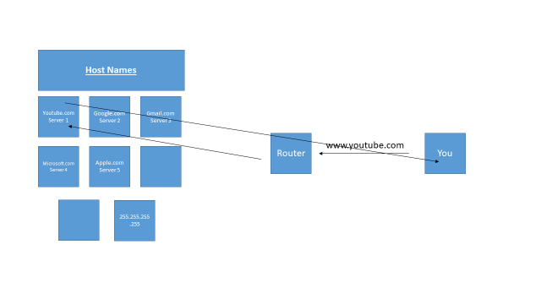
The Internet
By Austin H.

Slide 2
Definitions:
Internet:
TCP/IP protocols
a global computer network providing a variety of information and communication facilities, consisting of interconnected networks using standardized communication protocols.
Network:
interconnection of computers
Lan (Local Area Network)
Wan (Wide Area Network
Vpn (Virtual Private Network)
Server:
Host computer on network
Client:
Computers on a network that request files from a server.

Slide 3
History of the Internet:
Grew out of cold war between U.S. and Russia.
Nuclear Weapons
Technology
Space
Advanced Research Projects Agency
Researched creating a communication network capable of surviving a nuclear attack.
Created Arpanet (1969)
What is the Internet?
Lots of various connections that report and then get sent out to a specific person, within packets.
Information is sent through packets to their destinations where they are tabled in a router where routers can connect to each other to send the information.

Slide 4
How does the internet work?
By clicking the hyperlink, you are requesting a web site from a server.
The files are pulverized into packets
The packets are sent through networks to hubs
The packets are rebuilt on a requesters (clients) computer.

Slide 5
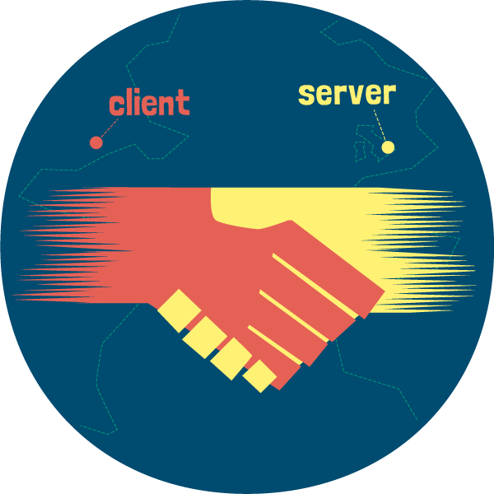
What is TCP/IP?
Protocols (standards and rules)
TCP/IP is the communication protocol for the internet.
TCP (transmission control protocol) breaks requested site/info down into packets (small chunks of data).
IP (internet protocol) adds addressed to and routes packets trough communication lines.
TCP reassembles packets into the information you were receiving.

Slide 6


What TCP looks like?

Slide 7

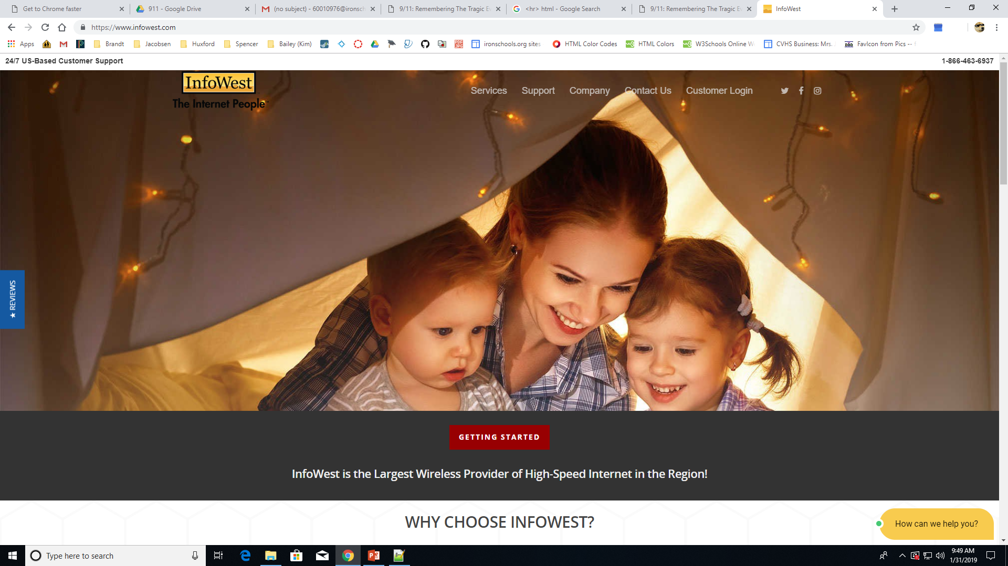
Internet Service Provider (ISP)
A Company that provides internet service for you. ($) to ($$$)

Slide 8
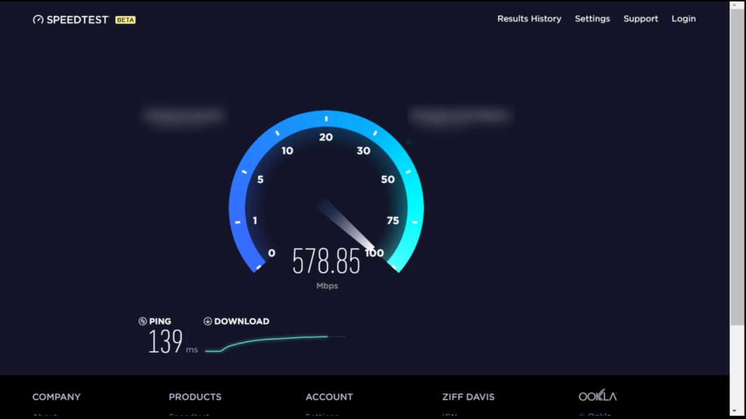
Bandwidth
Bandwidth is the range of transmission frequencies that a network can use. The greater the bandwidth.
369.54 Mbps – download
349.56 Mbps - Upload

Slide 9
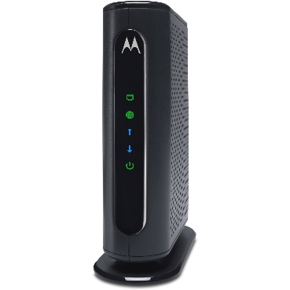
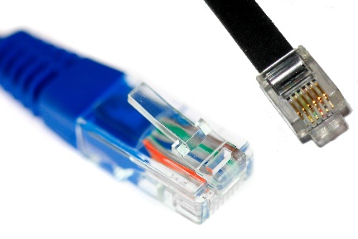
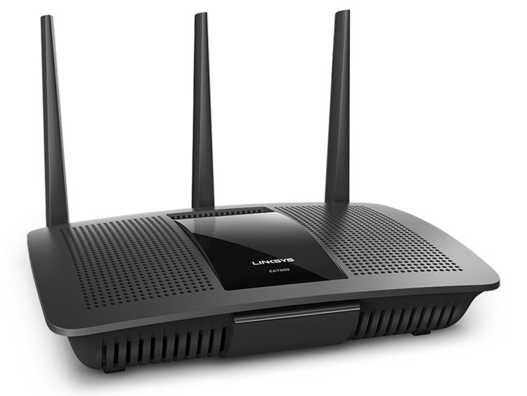
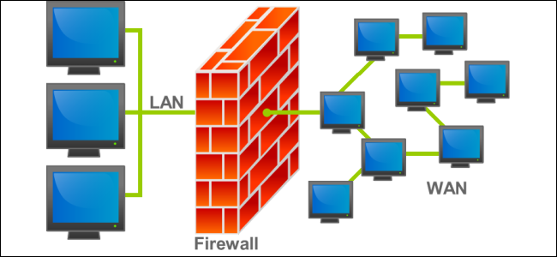
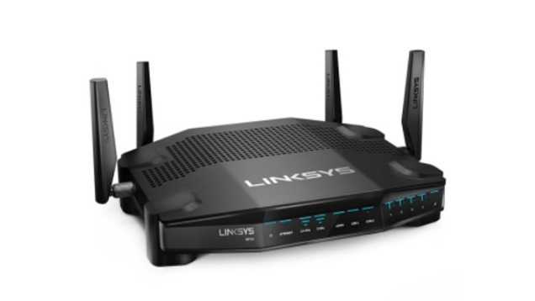
Hardware/Software for Internet
Modem: Connects to (ISP)
Router: Connects multiple networks and forwards packets.
Wireless Router: Essential part
Wi-Fi: Connection between your wireless devices and your router.
Cabling: The Physical connection like (RJ-45)
Firewalls: Allows and denies traffic (filtering)

